Slide 1
CSCE 823 Biological Inspiration (from “BNN” to ANN)
Dr. Brett Borghetti

Slide 2
Artificial Neural Networks What are ANNs?
Biologically-inspired computing methods
Engineering models of the human brain
They model physical aspects of the brain
Interactions between Neurons
Connectivity and high parallelism of neural computations
They DO NOT model
Psychological processes
More complex reasoning
Before we discuss the Artificial NN, lets look at the Biological NN

Slide 3
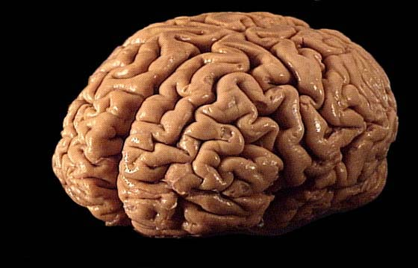
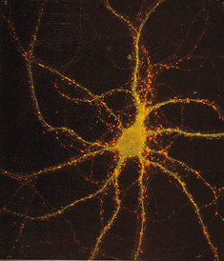
The Brain…
Factoids :
Average weight is 3lbs, 2% of your body weight
Has approx 100B neurons
Average Dimensions: 5.5”x6.6”x3.7 (WxLxH)
Cortex average area: 2.5ft²
12 Cranial Nerves
https://faculty.washington.edu/chudler/flash/facts.html

Slide 4
Central Nervous System
Central nervous system viewed as 3-stage system (Haykin99)
Stimulus– Auditory, Visual, Sensation
Receptors – Converts stimulus to electrical signals
Neural Net – This is the brain, processes the input signals
Effectors – Converts processed signals to outputs
Response – This is the output response
Receptors
Neural Net
Effectors
Stimulus
Response

Slide 5
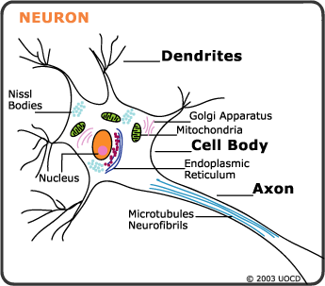
The Neuron
Receive stimuli and transmit action potentials to other neurons/effector organs
Comprised of:
Cell body
2 Processes
Dendrites
Axons

Slide 6
Neuron Cell Body
Also called the soma (body)
Dendrites & Axons attach to the cell body
http://understanding_ocd.tripod.com/ocd_neurons_serotonin.html

Slide 7
Dendrites (inputs)
Short extensions from the cell body
Surface of many have dendritic splines
Connect to axons of other neurons
Axon connections form synapses w/dendrites
Respond to neurotransmitter substances from the axons of other neurons by producing action potentials
Functionally
Conduct electrical signals towards cell bodies

Slide 8
Axon (output)
Single/branching structure from the soma
Has a constant diameter
Vary in length – few millimeters – 1M
Terminate by branching and forming presynaptic terminals
Contain neurotransmitter
Functionally
Conduct action potentials from the soma to the presynaptic terminals

Slide 9
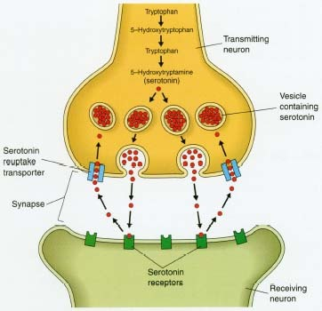
Synapse (connecting outputs)
Action potentials in one cell can initiate the production of action potentials in another cell at the synapse
Synapse is the junction between cells
First cell in process is the presnyaptic cell
Typically neurons
Second (responding) is postsynaptic cell
Typically neurons, muscle cells, or gland cells
Presynaptic Cell
Postsynaptic Cell
http://www.humanillnesses.com/images/hdc_0000_0001_0_img0054.jpg

Slide 10
Neural Factoids
Some facts
Data rate: 50 Baud (slow!)
Neuron switching time : > 10⁻³ secs
Number of neurons in the human brain: ~10¹⁰
Connections (synapses) per neuron : ~10⁴–10⁵
In Applications
Face recognition : 0.1 secs
Speed comes from the possibility of:
High degree of parallel computation
Distributed representations
Likely our effectiveness and efficiency comes from our representation of the world and our ability to link sensory inputs, memories, and knowledge to do complex tasks

Slide 11
Key Network Concepts: What ANNs model from BNNs
Weighted Summation of electro-chemical inputs from other neurons
The multi-layer architecture/structure of the network (nodes, connections, layers)

Slide 12
Key Network Concepts: How ANNs differ from BNNs (1/2)
The neural firing function – how a signal is transferred from one neuron to the next
Biological Neurons use a leaky form of (calculus) integration to determine when to fire
Artificial Neurons employ a math function on the summation (e.g. sigmoid, Heaviside, ReLU)

Slide 13
Key Network Concepts: How ANNs differ from BNNs (2/2)
How the network learns
Biological explanations of how neural connections “learn” include Hebbian learning which could occur in each forward pass
ANN’s use backprop to learn (requires explicit training in forward & backwards pass)
Because ANNs are deliberately trained, ANNs require an explicit Loss/Cost Function for updating connection weights between layers

Slide 14
Summary of Key Concepts
The architecture/structure of the network (nodes, connections, layers)
The weighted summation and activation function
The update/learning rule (example: backprop)
The Loss/Cost Function (example: RMSE)

